Slide 1


CHCCCS031
Provide individualised support (Release 1)

Slide 2

About this Unit of Competency
CHCCCS031 - Provide individualised support (Release 1)
This unit describes the performance outcomes, skills and knowledge required to organise, provide and monitor personal support services for a person within the limits established by an individualised plan.

Slide 3
The individualised plan refers to the support or service provision plan developed for the person accessing the service and may have different names in different organisations.
This unit applies to workers who provide care or support under direct or indirect supervision. Work is carried out in a manner which supports independence as well as the physical and emotional wellbeing of the person receiving support.
The skills in this unit must be applied in accordance with Commonwealth and State/Territory legislation, Australian standards and industry codes of practice.

Slide 4

Presentation Objectives
At the end of this session, you will be able to:
Determine personal support requirements
Provide support services
Monitor support activities
Complete reporting and documentation

Slide 5
Introduction
Individualised support refers to providing personal care and assistance to people who need it.
Assistance means helping individuals in all aspects of their daily life including:
Social and physical activities
Personal hygiene
Mobility
Mealtimes
As a carer, you must be prepared to work with and care for diverse people.

Slide 6
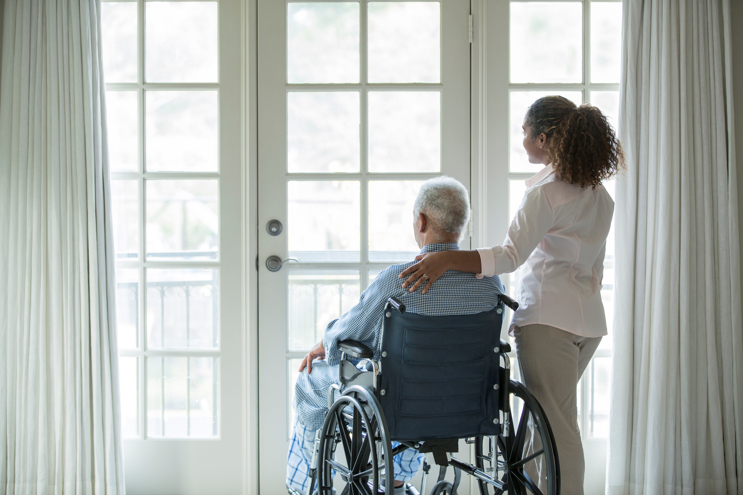
The Carer Recognition Act 2010 (Cth):
Is the Act that recognises and promotes carers’ role in providing daily care and support
Enumerates the people you may provide support and care to as a care worker.

Slide 7

Under the Carer Recognition Act 2010 (Cth), people receiving support include those who:
Have a disability; or
Have a medical condition (including terminal or chronic illness); or
Have a mental illness; or
Are frail and aged

Slide 8
Depending on their needs, people will need support from different professionals including:
School staff
Doctors
Therapists
Part of your job is to provide and monitor their support services that are within limits established by their individualised plan.

Slide 9
The individualised plan can cover a range of support activities that respond to a person and should include:
An outline of the person’s goals, needs, and preferences
The support services that will be provided to address the goals and needs of the person
Who will provide the support services mentioned.

Slide 10
Each detail in the individualised plan then must be agreed upon by the following involved:
The person receiving support
The family of the person
The carer of the person
Others identified by the person

Slide 11

Determine Personal Support Requirements
CHCCCS031 - Provide individualised support (Release 1)

Slide 12
An individualised plan:
Aids people in receiving support to live independent lives
Ensures that they have the support services, aids and equipment they need to maintain and improve the quality of their lives
To provide a person with individualised support, you must determine their service requirements.
Determine Personal Support Requirements

Slide 13
Personal service requirements refer to the following of each person:
Needs
These refer to what is necessary for the person to live an independent and fulfilling life.
Needs
Goals
Preferences
Determine Personal Support Requirements

Slide 14
Personal service requirements refer to the following of each person:
Goals
These refer to what aspirations the person generally wants to achieve in their life.
Preferences
These refer to what the person chooses when presented with various options.
Determine Personal Support Requirements

Slide 15

1.1 Confirm Support Services by Referring to the Plan

Slide 16
Part of your job as a care worker is to provide individualised support to your clients.
You must:
First confirm what support services are in their individualised plan to ensure that the support you will provide to clients is in line with what they need and prefer
Engage with your client and their support team to ensure that your support is tailored specifically for the client
Determine Personal Support Requirements

Slide 17
The PWD may want the following people involved:
Advocates
Behaviour consultants
Development officers
Support workers
School support staff
Employment officers
Occupational therapists
Programming staff
Technicians
Determine Personal Support Requirements

Slide 18
The PWD may want the following people involved:
Advocates
Are non-lawyer professionals who stand up for the rights of PWDs
Help sort out issues that may arise in their care
Provide support and legal assistance in enforcing their rights
Raise awareness on situations where PWDs are mistreated
Consulting with them can give you insight into possible individualised support.
Determine Personal Support Requirements

Slide 19

The PWD may want the following people involved:
Behaviour Consultants
People with acquired brain injury may want to include their behaviour consultants in their care plan as they frequently experience behavioural changes.
Determine Personal Support Requirements

Slide 20
The PWD may want the following people involved:
Behaviour Consultants
Behaviour consultants assist a person in understanding and managing their behavioural changes.
It will be vital for you to include your clients’ behavioural consultants in planning their individualised plan as they can give you insight and advice on any necessary adjustments.
Determine Personal Support Requirements

Slide 21
The PWD may want the following people involved:
Development Officers
Oversee the programs of the organisations they belong to.
Strive to engage and work with people receiving support to address their needs with help and support.
Determine Personal Support Requirements

Slide 22
The PWD may want the following people involved:
Support Workers
Support workers provide care and help to clients in performing daily tasks including the following:
Basic Hygiene
Daily Living
Bathing and showering
Oral hygiene
Dressing
Grocery shopping
Budgeting money
Cooking
Determine Personal Support Requirements

Slide 23
The PWD may want the following people involved:
Support Workers
For clients who already have support workers assisting them, you may consult with these support workers.
The support workers can:
Give you insightful information on their current skillset and needs
Provide information on the activities currently being implemented
Determine Personal Support Requirements

Slide 24
The PWD may want the following people involved:
School Support Staff
School support staff ensure that students learn in a safe and supportive environment.
Staff such as teachers, counsellors, and nurses ensure that the school meets the following needs of all students:
Academic
Personal
Social
Career development
Determine Personal Support Requirements

Slide 25
The PWD may want the following people involved:
Employment Officers
Employment officers assist the person in gaining the skills and confidence they need to find and secure employment.
Disability Employment Services (DES):
Help PWDs find and secure work.
Ensure that the workplace can support both the employer and employee.
Determine Personal Support Requirements

Slide 26
The PWD may want the following people involved:
Employment Officers
Disability Employment Services consist of two parts:
Disability Management Service
This service supports employees with mild to moderate impairments. They need help finding employment. They also provide occasional support in the workplace.
Determine Personal Support Requirements

Slide 27
The PWD may want the following people involved:
Employment Officers
Disability Employment Services consist of two parts:
Employment Support Service
This service supports employees with severe impairments who need help in finding employment. They also provide regular, ongoing support in the workplace.
Determine Personal Support Requirements

Slide 28
The PWD may want the following people involved:
Occupational Therapists
Provide physical care to PWDs
Make sure that the person can live an independent life
Are trained to assess the person’s skills
Determine Personal Support Requirements

Slide 29
The PWD may want the following people involved:
Occupational Therapists
Consulting with your client’s occupational therapist will benefit the individualised plan.
They can provide information on the client’s physical and fine motor skill needs.
Therapists can also explain what treatments will help the person.
Determine Personal Support Requirements

Slide 30

The PWD may want the following people involved:
Programming Staff
Ensure that programs and events in their organisation are fully accessible
Make sure that disabled participants can access and participate just like everyone else
Determine Personal Support Requirements

Slide 31
The PWD may want the following people involved:
Technicians
Technicians support PWDs in developing their communication, mobility and social skills.
If a client requires the need for equipment to perform their daily activities, you can consult the help of a technician.
Determine Personal Support Requirements

Slide 32
Each member of the support team then plays an important role in the client’s individualised plan. They each have their own responsibilities in ensuring that the client gets the care they need. They also communicate different information between them.
Person Being Supported
Responsibilities
They respect the rights and needs of other people within the care service and the needs of the care service community as a whole.
Determine Personal Support Requirements

Slide 33
They also communicate different information between them.
Person Being Supported
Responsibilities
They respect the rights of staff to work in an environment free from harassment. They care for their own health and wellbeing, as far as they are capable.
Determine Personal Support Requirements

Slide 34
They also communicate different information between them.
Person Being Supported
What They Communicate to Support Workers and Healthcare Professionals
Medical concerns or issues Requests such as an increase in dosage for pain management medication Signs and symptoms experienced
Determine Personal Support Requirements

Slide 35
The client’s family and carer have their own responsibilities and things to communicate:
Family and Carer of the Client
Responsibilities
They are an important source of emotional support for the client. Family members, relatives, and friends support the client at home when the carer is unavailable, such as at night or on day-offs.
Determine Personal Support Requirements

Slide 36
The client’s family and carer have their own responsibilities and things to communicate:
Family and Carer of the Client
Responsibilities
Caregivers ensure that the client is participating in their support activities and taking their prescribed medication.
Determine Personal Support Requirements

Slide 37
The client’s family and carer have their own responsibilities and things to communicate:
Family and Carer of the Client
What They Communicate to Support Workers and Healthcare Professionals
Changes to the person’s health and wellbeing Signs and symptoms observed
Determine Personal Support Requirements

Slide 38
The client’s family and carer have their own responsibilities and things to communicate:
Healthcare Professionals
Responsibilities
They ensure the care and support provided to the client are in line with the client’s healthcare needs.
Determine Personal Support Requirements

Slide 39
The client’s family and carer have their own responsibilities and things to communicate:
Healthcare Professionals
Responsibilities
They diagnose, treat and prevent any illness, injury and other impairments that the client may have. Nurses assist doctors in carrying out medical orders.
Determine Personal Support Requirements

Slide 40
The client’s family and carer have their own responsibilities and things to communicate:
Healthcare Professionals
What They Communicate to the Person Being Supported and Their Family and Carers
The health status of the client The assessment and diagnosis of the client’s healthcare needs The treatment and medication plan of the client
Determine Personal Support Requirements

Slide 41
The client’s family and carer have their own responsibilities and things to communicate:
Healthcare Professionals
Responsibilities
They provide physical care and emotional support to clients who require assistance with daily tasks. They ensure that the client is participating in their support activities.
Determine Personal Support Requirements

Slide 42
The client’s family and carer have their own responsibilities and things to communicate:
Healthcare Professionals
Responsibilities
They administer first aid when needed. They work within their scope of responsibilities and report concerns when necessary.
Determine Personal Support Requirements

Slide 43
The client’s family and carer have their own responsibilities and things to communicate:
Healthcare Professionals
What They Communicate to the Person Being Supported and Their Family and Carers
The rights of the person and their family and carers Information about the service delivery Information about support activities
Determine Personal Support Requirements

Slide 44
1.1.1 Components of the Individualised Plan
The following are the components of an individualised plan:
Needs of the client
Required personnel assistance
Resources needed
Support services
Goals of the client
Determine Personal Support Requirements

Slide 45
The following are the components of an individualised plan:
Needs of the Client
The following are examples of needs that a client may have:
Physical needs
Sensory needs
Emotional needs
Cultural needs
Determine Personal Support Requirements

Slide 46
The following are the components of an individualised plan:
Goals of the Client
As a care worker, you must identify the goals that will guide you, your client, and their support system.
To do so, you may work with the client to set their goals.
Goal setting refers to deciding what the client wants to achieve.
Determine Personal Support Requirements

Slide 47
The following are the components of an individualised plan:
Goals of the Client
When setting goals, you must first consider the client’s long- and short-term goals.
Long-term goals
Refer to the goals the client wants to accomplish in the far future.
Short-term goals
Refer to the goals the client wants to accomplish soon.
Determine Personal Support Requirements

Slide 48

The following are the components of an individualised plan:
Goals of the Client
To further break down the long and short-term goals, you may use the SMART goals framework as the guiding principle.
Determine Personal Support Requirements

Slide 49

The following are the components of an individualised plan:
Goals of the Client
The following are the SMART goals framework:
Specific - The goals set should be well-defined and clear for more effective planning.
Measurable - The goals set should have the means to track the progress of the person objectively.
Achievable - The goals set should be realistic and within the capacity of the client.
Determine Personal Support Requirements

Slide 50
The following are the components of an individualised plan:
Goals of the Client
The following are the SMART goals framework:
Relevant - The goals set should be beneficial to the client.
Time-bound - The goals set should have a start and finish date to give a sense of urgency.
Determine Personal Support Requirements

Slide 51

The following are the components of an individualised plan:
Support Services
Support services refer to the services performed or provided to promote, improve or restore a person’s wellbeing.
Daily living refers to the self-care activities people do every day to keep themselves safe, healthy and feeling good.
Determine Personal Support Requirements

Slide 52
The following are the components of an individualised plan:
Support Services
The two kinds of activities for daily living are as follows:
Activities of Daily Living (ADL)
These include the self-care tasks at home.
Instrumental Activities of Daily Living (IADL)
These refer to activities for maintaining an independent life at home and other environments.
Determine Personal Support Requirements

Slide 53
The following are the components of an individualised plan:
Support Services
The following are an array of services people receiving support can be provided with:
Dietetics
Dietetic refers to the effects of food and nutrition on human health.
Medication
Medication support services include the prescribing, administering and monitoring of medicine.
Determine Personal Support Requirements

Slide 54

The following are the components of an individualised plan:
Support Services
The following are an array of services people receiving support can be provided with:
Occupational therapy
Occupational therapy is a treatment to improve motor skills, balance and coordination.
Determine Personal Support Requirements

Slide 55
The following are the components of an individualised plan:
Support Services
The following are an array of services people receiving support can be provided with:
Physiotherapy
Physiotherapy treats people who need support in mobility, function and wellbeing.
Speech therapy
Speech therapy refers to treating a broad range of speech and language disorders.
Determine Personal Support Requirements

Slide 56
The following are the components of an individualised plan:
Required Personnel Assistance
As a care worker, you:
Must determine who will supervise and aid your clients when needed
Need to ease this process and ensure that your clients and their entire support team are involved and have access to the list
You must consult with your clients regarding the relevant personnel they want help from.
Determine Personal Support Requirements

Slide 57
The following are the components of an individualised plan:
Resources Needed
The individualised plan should list what specific aids and equipment are needed and how they will use them in each response.
Resources may include the following:
Material resources
Human resources
Determine Personal Support Requirements

Slide 58
1.1.2 Confirming Support Services to be Provided
To confirm the support services, know the answer to the following questions:
What are the client's goals, needs, rights and preferences?
What support services address the client's goals and needs?
What are the treatment plans and medication prescribed by the client's healthcare professionals?
Determine Personal Support Requirements

Slide 59
To confirm the support services, know the answer to the following questions:
What support services am I qualified to provide are within the individualised plan?
If there is a support service I am not qualified to provide, to whom do I refer the client to?
What support services that the family of the client can provide assistance with?
Who are the staff members that are already providing the client's support services?
Determine Personal Support Requirements

Slide 60

1.2 Consult With the Person and Their Support Team to Determine Any Specific Needs or Preferences

Slide 61
A care worker who works with the person is expected to provide individualised support in the form of:
Education
Appropriate care strategies
Use of assistive technology
Determine Personal Support Requirements

Slide 62

To consult with your client and their support team, you must ensure that you:
Understand your clients and their impairments
Identify and respect the cultural needs of your clients
Recognise the strengths and capabilities of your clients
Determine Personal Support Requirements

Slide 63
1.2.1 Understand Your Clients and Their Impairments
To understand your clients better and make it easier to state their physical and sensory needs you must understand the social model of disability and the rights of those receiving support.
Social Model of Disability
The model states that impairments are not the leading cause of disability. It is the barriers set by society that disables people.
Impairment is a medical condition that leads to disability.
Determine Personal Support Requirements

Slide 64
Social Model of Disability
Impairment is defined as losing control over the body's physical, cognitive, or anatomical functions. Impairment can range between three levels.
Mild
Impairments cause minor discomfort and changes in physical, social or occupational function.
Moderate
Impairments cause a notable amount of discomfort.
Severe
Impairments cause an extreme amount of discomfort.
Determine Personal Support Requirements

Slide 65
Social Model of Disability
Disability refers to the relationship between people with impairments and barriers set by society.
The following are common struggles that people receiving support may face:
Lack of services and support
Lack of aids, equipment and assistive technologies
Determine Personal Support Requirements

Slide 66
Social Model of Disability
The following are common struggles that people receiving support may face:
Lack of housing options
Difficulties in seeking, obtaining and retaining employment
Lack of access to the built environment and information
Determine Personal Support Requirements

Slide 67
Handicap and Discrimination
When a person with an impairment interacts with society, they often experience discrimination.
The Disability Discrimination Act 1992 defines discrimination against people with disabilities. Discrimination comes in two forms:
Direct discrimination
Indirect discrimination
Determine Personal Support Requirements

Slide 68
Handicap and Discrimination
The Disability Discrimination Act 1992 defines discrimination against people with disabilities.
Discrimination comes in two forms:
Direct discrimination occurs when a person is treated worse than another person.
Indirect discrimination occurs when a policy or requirement disadvantages a person receiving support.
Determine Personal Support Requirements

Slide 69
Handicap and Discrimination
Age Discrimination Act 2004 defines discrimination against older persons.
Discrimination comes in two forms:
Direct discrimination
Indirect discrimination
A common age-related experience of discrimination is invisibility.
Determine Personal Support Requirements

Slide 70

The Human Rights of People Receiving Support
Human rights
Are the standards that are used to recognise and protect the dignity of all humans
Serve as the basis for laws and acts governing people and communities
Determine Personal Support Requirements

Slide 71
The Human Rights of People Receiving Support
The Australian Human Rights Commission (2019) defines that human rights:
Recognise the inherent value of each person
Are based on principles of dignity, equality and mutual respect
Are about being treated fairly, treating others fairly and having the ability to make genuine choices in our daily lives
Determine Personal Support Requirements

Slide 72
The Human Rights of People Receiving Support
The rights of people receiving support can be found in the following declarations and treaties:
All care workers must know and understand the basic human rights that apply to everyone.
Universal Declaration of Human Rights (UDHR)
Convention on the Rights of Persons with Disability (CRPD)
Determine Personal Support Requirements

Slide 73
The Human Rights of People Receiving Support
Care workers who support people with disabilities must understand the CRPD.
The CRPD contains general and specific obligations which aim to protect the rights of all persons with disabilities. There are two documents in the CRPD:
The actual rights of people with disabilities that must be upheld
An optional protocol for upholding these rights and addressing complaints
Determine Personal Support Requirements

Slide 74
The Human Rights of People Receiving Support
Human rights are vital for a person to understand any specific needs or preferences they may have.
A person who knows their rights has a better understanding of:
What they are entitled to
What others are not allowed to do
And what the state or country, as a whole, is required to do to accommodate them
Determine Personal Support Requirements

Slide 75
You need to ask your clients and their support team the following questions to determine any of their needs or preferences:
To the client:
What impairments do you have? Are they physical, cognitive or anatomical? What is the level of the impairment? Is it mild, moderate or severe? What physical or sensory needs do you have based on your impairments?
Determine Personal Support Requirements

Slide 76
You need to ask your clients and their support team the following questions to determine any of their needs or preferences:
To the client:
Which barriers do you face the most in your daily life? What stops you from participating in your community? Have you felt like you were discriminated against due to your age or disability?
Determine Personal Support Requirements

Slide 77
You need to ask your clients and their support team the following questions to determine any of their needs or preferences:
To the support team:
What assistance do you provide the person based on their impairments? What assistance do you think the person is still in need of? What barriers have you observed that the person faces the most? What do you think needs to be addressed for the person to participate in their community?
Determine Personal Support Requirements

Slide 78
1.2.2 Identify and Respect the Cultural Needs of Your Clients
Cultural needs refer to a wide variety of needs based on a person's social and ethnic identity.
Cultural needs can be based on ethnic background combined with:
Sexual orientation
Religion
Other forms of group identification
Determine Personal Support Requirements

Slide 79
Providing your clients’ cultural needs is a requirement for providing individualised support and have the following benefits:
It allows your clients to recover more easily from stress.
It distracts your clients from their medical problems or condition.
It helps your clients recover and heal more quickly.
It reduces the risk of depression and other emotional problems.
It improves the relationship between your clients and the staff caring for them.
Determine Personal Support Requirements

Slide 80
Identifying, Respecting, and Upholding the Cultural Needs of Your Clients
The following steps show how a care worker can identify, respect and uphold the cultural needs of their client:
Secure a good understanding of your client’s cultural needs.
Provide your client’s cultural needs daily.
Adjust service based on your client’s feedback and reactions.
Determine Personal Support Requirements

Slide 81
1.2.3 Recognise the Strengths and Capabilities of Your Clients
Below are basic principles to guide you in determining the strengths and capabilities of your clients:
All care strategies must focus and draw on the client’s strengths and capabilities.
All clients have a responsibility to maintain and improve their well-being.
All clients have the capacity to learn, improve and change.
Determine Personal Support Requirements

Slide 82

When using strength-based approaches, a care worker must:
Assess the strengths and capabilities of their clients and use them in developing and implementing responses
Maximise the use of resources available to their clients to improve their condition
Determine Personal Support Requirements

Slide 83
When using strength-based approaches, a care worker must:
Induce hope in their clients by affirming their improvement and showing an appreciation for their capability
Allow their clients to choose what they want to do or how they want to work on their problems
Remember that using the strength-based approaches is important in individualised support.
Determine Personal Support Requirements

Slide 84
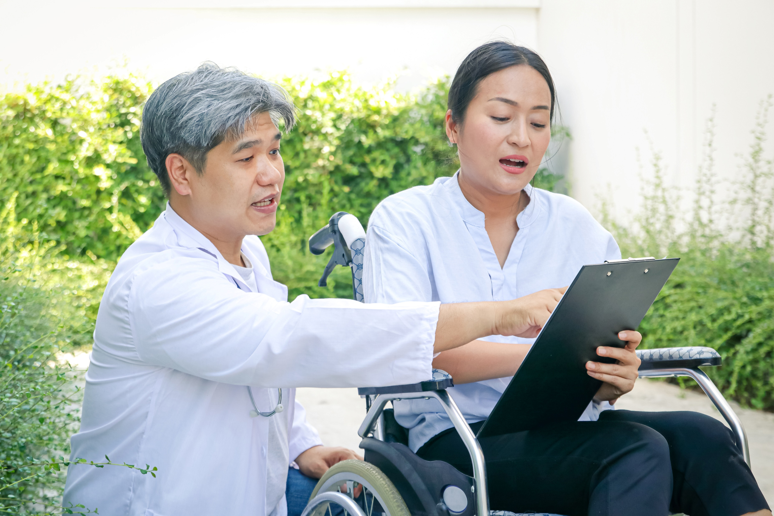
1.3 Discuss and Confirm the Person’s Preferences for Support and the Level of Their Participation

Slide 85
Before providing your clients with this support, it is vital that you discuss and confirm their preferences for the following:
To do so, you must follow the basic principles of person-centred practice.
Personal support
Own level of participation in meeting their support needs
Determine Personal Support Requirements

Slide 86

A person-centred practice:
Supports the person, at the ‘centre of the service,’ to be involved in making decisions about their life
Takes into account each person’s life experience, age, gender, culture, heritage, language, beliefs and identity
Determine Personal Support Requirements

Slide 87
A person-centred practice:
Requires flexible services and support to suit the person’s wishes and priorities
Is strengths-based, where people are acknowledged as the experts in their life with a focus on what they can do first and any help they need a second
Includes the person’s support network as partners
Determine Personal Support Requirements

Slide 88
You must also understand the difference between a person-centred model and the institutionalised model of support.
The person-centred model, also known as self-directed model, provides the individual more control over their lives.
The institutionalised model of support gives more control to the care facility in directing the support of the individual.
Determine Personal Support Requirements

Slide 89

A person-centred practice has the following benefits:
Clients will generally have an easier time developing and maintaining trust in you.
Clients will be more compliant with routines, activities and programs designed based on their needs and preferences.
Determine Personal Support Requirements

Slide 90
A person-centred practice has the following benefits:
You will not have a difficult time coming up with support strategies for your clients.
You will not need to spend a lot of time and effort convincing your clients to participate in certain activities.
Determine Personal Support Requirements

Slide 91
Discussing and Confirming With Your Clients on Their Preferences
When discussing with clients on their preferences and level of participation, you must:
Ensure the rights of the client are upheld
Ensure that the needs of the client are upheld
Determine Personal Support Requirements

Slide 92
Discussing and Confirming With Your Clients on Their Preferences
Below are some strategies you may use to confirm clients’ preferences for support and participation in meeting their needs:
Ask the client to repeat what they said.
Repeat and restate what the client said.
Thank the client and show your understanding.
Determine Personal Support Requirements

Slide 93

1.4 Identify Actions and Activities That Promote Independence and Decision-Making

Slide 94
After getting to know your clients’ needs and preferences, you can identify actions and activities that do the following:
Support your clients' individualised plan
Promote your clients' independence
Promote your clients' right to informed decision making
Determine Personal Support Requirements

Slide 95
1.4.1 Determining Actions and Activities With Your Clients That Support Their Individualised Plan
Actions and activities that support your clients’ individualised plan must prioritise the following:
Goals of the client
Needs of the client
Preferences of the client
Determine Personal Support Requirements

Slide 96
Here are some strategies you may use to identify actions and activities that support the individualised plan with your clients:
Confirm the support services to be provided based on the individualised plan.
Assess the actions and activities within the confirmed support services.
Start conversations with the client regarding their individualised plan.
Determine Personal Support Requirements

Slide 97
1.4.2 Determining Actions and Activities With Your Clients That Promote Their Independence
Actions and activities that promote your clients’ independence are the ones that empower them to improve their life.
Empowering:
Means giving a person the power to control their lives
Involves investing valuable time, effort and resources for them to become stronger and more confident
As a care worker, you must ensure that your clients can exercise their independence in the identified actions and activities.
Determine Personal Support Requirements

Slide 98
Active Support
Active support is the practice of providing the appropriate amount of support that can empower the person.
Regardless of your clients’ level of impairment, you must work with them to participate in any action or activity and you must be able to abide by the following basic principles:
Belongingness
Opportunity
Respect
Self-control
Determine Personal Support Requirements

Slide 99
Active Support
Here are some strategies to aid your process in identifying actions and activities with your clients that promote their independence:
Break down actions or activities to be more manageable.
Determine what assistance is needed.
Maximise the client’s choice and control.
Determine Personal Support Requirements

Slide 100
1.4.3 Determining Actions and Activities With Your Clients That Promote Their Right to Informed Decision-Making
Actions and activities that promote your clients’ right to informed decision-making are the ones where your clients provide their informed consent.
Consent refers to the permission given by one person to another to do a specific action.
Informed consent is when they have all the knowledge they need to make a good decision.
Determine Personal Support Requirements

Slide 101

To identify actions and activities with your clients that promote their right to informed decision-making, you may consider doing the following:
Discuss all essential details with the client.
Respect the client’s wishes.
Make sure to prevent others from forcing the client from consenting to an action or activity.
Determine Personal Support Requirements

Slide 102
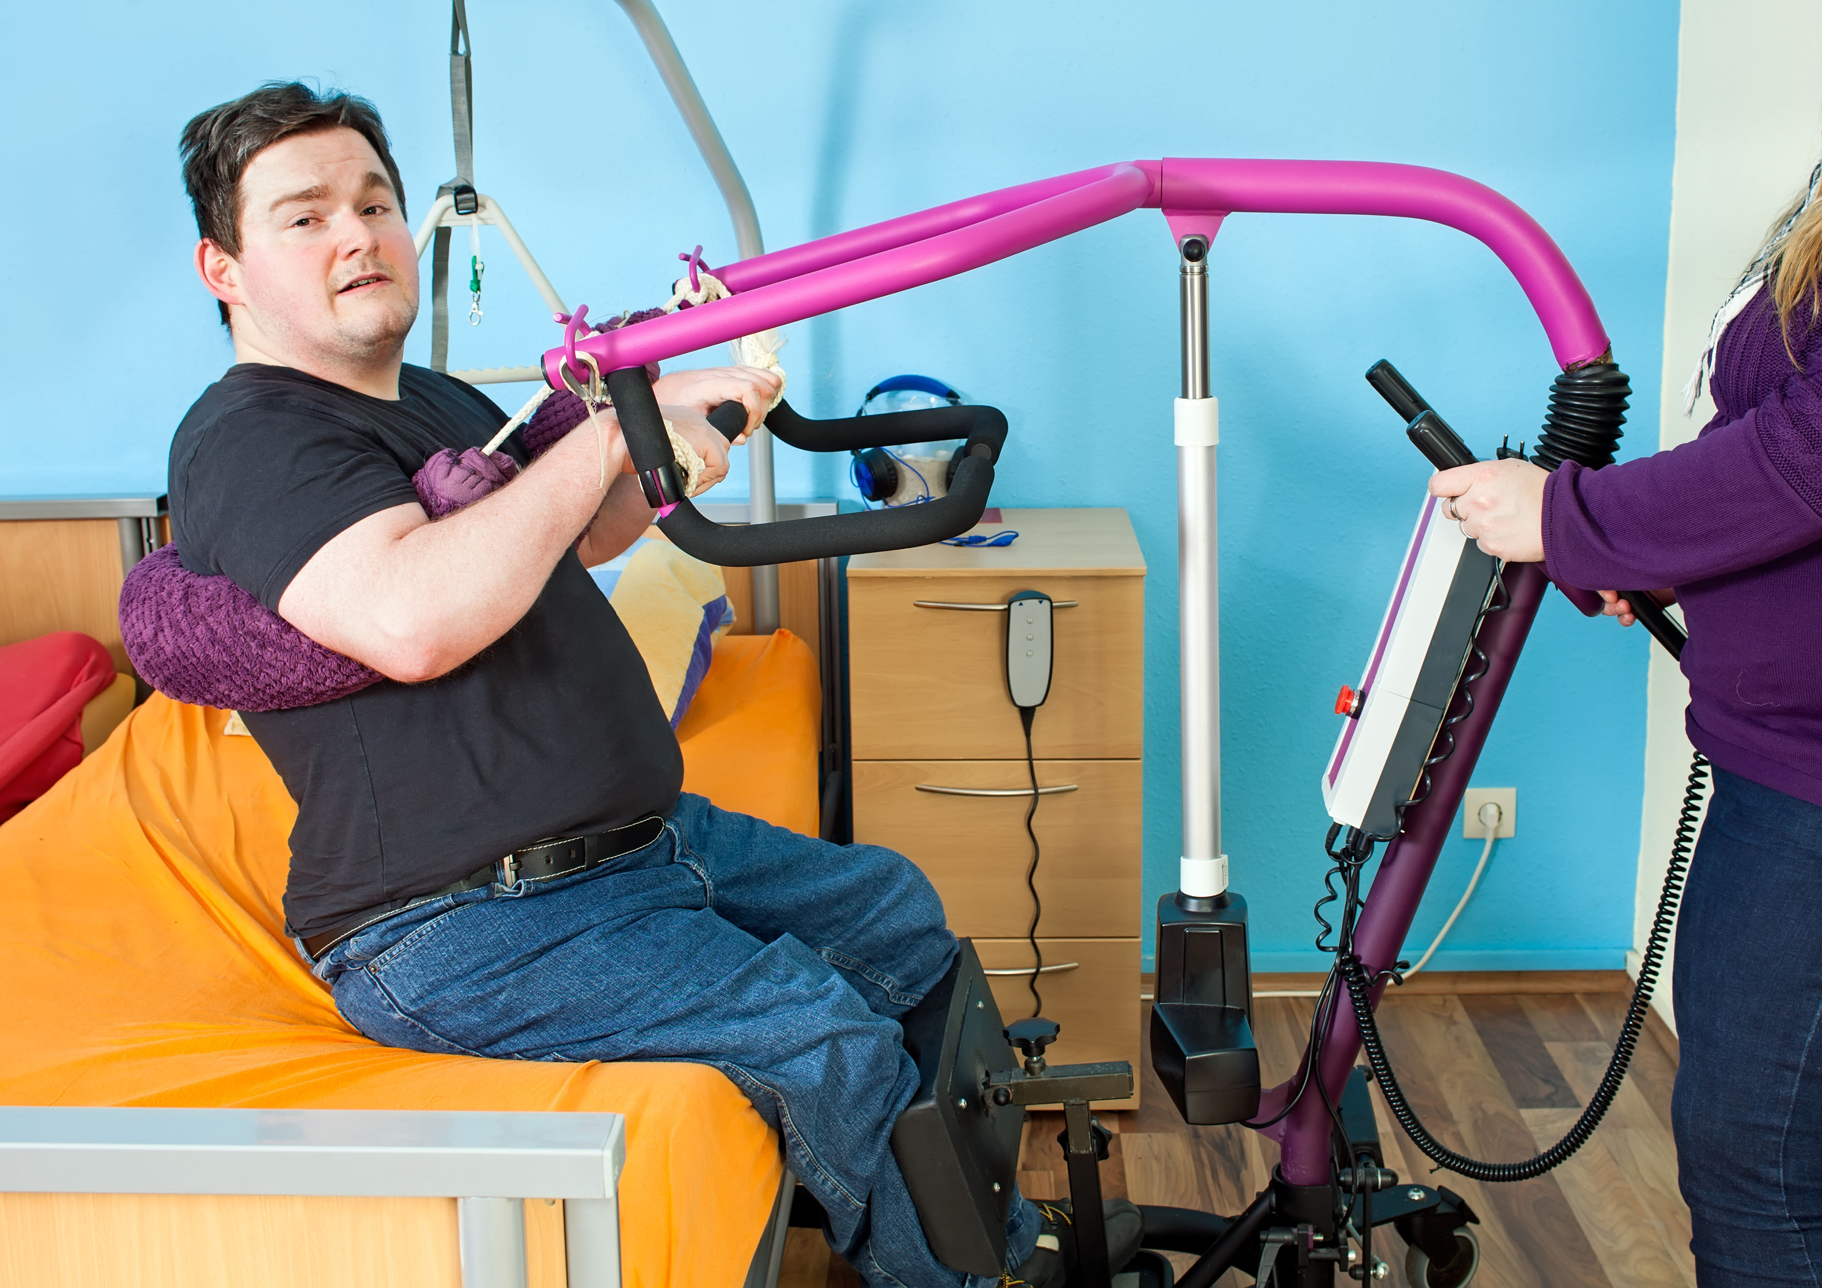
1.5 Prepare for Support Activities by Confirming and Assembling Equipment, Processes, and Aids

Slide 103
To prepare for your clients’ support activities, you must confirm and assemble what is needed for your client to use, which include the following:
Equipment refers to the assistive technology (AT) that helps a person as they participate in their support activities.
Processes refer to the sequence of tasks or steps taken to reach a specific outcome for each support action or activity.
Aids, like equipment, refer to the AT that assist a person to participate in their support activities.
Determine Personal Support Requirements

Slide 104
Confirming the Required Equipment, Processes and Aids
When confirming the required equipment, processes and aids, consider the following:
Review the individualised plan of your clients.
Assess the client for AT needs.
Consider the way your clients will interact with the equipment, processes and aids.
Determine if the person needs custom-made equipment or aids.
Consider the budget of your clients.
Determine Personal Support Requirements

Slide 105
Assembling the Required Equipment, Aids and Appliances
As a care worker, one of your responsibilities is to ensure the safety of your clients.
Standards are established documents that set out rules to ensure quality.
There are equipment, aids and appliances that need to meet Australian or other standards.
These standards may relate to the materials used, manufacturing and assembly or installation.
Determine Personal Support Requirements

Slide 106
Assembling the Required Equipment, Aids, and Appliances
Below are organisations that can provide you information on quality standards to keep in mind when assembling an equipment, aid, or appliance.
Standards Australia
Product Safety Australia
Furntech
Novitatech
Choice
Determine Personal Support Requirements

Slide 107
Once you have confirmed and assembled what your clients need, consider the following as you prepare for support activities:
Review the support activities listed in the client’s individualised plan.
Make sure that the equipment, process or aid is within the client’s preferences.
Prepare for support activities according to organisational policies and procedures.
Make sure that assistive devices and equipment are available.
Instruct the client on how to operate the equipment, aid or appliance.
Determine Personal Support Requirements

Slide 108

1.6 Identify Requirements Outside of the Scope of Own Job Role and Seek Support

Slide 109
As a care worker, it is essential to know the scope of your role. When working with people receiving support, you should:
Know what you are and are not qualified to do
Confirm job role requirements with the supervisor
Know when to seek the support of your supervisor
Determine Personal Support Requirements

Slide 110
1.6.1 Understanding Scope of Own Job Role
The scope of your job role is the limitation of your role based on your position and training.
To understand the scope of your own job role, you must know the legal and ethical requirements of the following and how they are applied to your organisation and individual practice:
Dignity of risk
Duty of care
Work-role boundaries
Code of conduct
Determine Personal Support Requirements

Slide 111

Code of Conduct
A code of conduct is the policy that lays out an organisation's principles and standards.
It also outlines various expectations that all support workers must adhere to.
Determine Personal Support Requirements

Slide 112
Code of Conduct
Codes of conduct for care workers and other professionals typically include:
Obligations as a care worker
Minimum standards for appropriate behaviour
Example scenarios and situations that require workers to evaluate their actions
Policies expressing zero tolerance of abuse and neglect
Determine Personal Support Requirements

Slide 113
Dignity of Risk
Dignity of risk is accepting that a person can choose what they do and how they live.
You have the duty to respect their dignity by helping them carry out their choices despite the risks.
You and the support team should help minimise the risk involved with the client’s choices.
Determine Personal Support Requirements

Slide 114
Duty of Care
A duty of care is a legal obligation that requires care workers to always act in their clients’ best interests.
A care worker with a duty of care to a client must ensure that your clients do not receive any form of harm, including but not limited to:
Physical
Emotional
Mental.
Determine Personal Support Requirements

Slide 115

Work-Role Boundaries and Limitations
Setting clear boundaries have the following benefits for you and your organisation:
You will be able to provide effective and goal-directed service.
You can avoid running into awkward situations with your clients and their loved ones.
Determine Personal Support Requirements

Slide 116
Work-Role Boundaries and Limitations
Setting clear boundaries have the following benefits for you and your organisation:
You can prevent balancing a personal and professional relationship with your clients.
You can prevent your clients from exhibiting inappropriate behaviour. This includes making excessive or unnecessary demands. Doing so will help you avoid being stressed or burnt out.
You will not have to experience emotional pain when your client leaves or passes away.
Determine Personal Support Requirements

Slide 117
Work-Role Boundaries and Limitations
Setting clear boundaries have the following benefits for you and your organisation:
You will be able to secure your information and that of your co-workers and clients.
You and your co-workers will maintain professionalism when interacting with and supporting your clients.
Determine Personal Support Requirements

Slide 118
1.6.2 Confirming Job Role Requirements With Supervisor
To identify requirements outside of the scope of your job role, you must first determine the limits of your role by confirming your responsibilities and expectations with your supervisor.
Your supervisor must communicate with you the following:
Organisational policies and procedures
Instructions and guidance for implementing clients' individualised plans
Health and safety reminders
Service standards
Determine Personal Support Requirements

Slide 119
When confirming job role requirements with your supervisor, you may ask them the following questions:
What tasks can I perform?
What tasks am I not allowed to perform?
What will my typical workday look like?
What are my main responsibilities?
What are other possible responsibilities might get assigned to me?
If there is a task I am not allowed to perform, to whom do I refer my client to?
Determine Personal Support Requirements

Slide 120
Some things you must communicate to your supervisors include:
Changes to the person’s health and well-being
Incidents or near misses
Issues and other concerns not covered in the individualised support
Feedback from the person being supported on support activities
Signs or indicators of abuse or neglect
Determine Personal Support Requirements

Slide 121
1.6.3 Seeking Support From Supervisor
You can refer to the following strategies when seeking support from your supervisor:
Identify the part of your client’s care that falls outside your job role.
Consider the best time to seek support.
State what you need clearly, briefly and honestly.
Communicate any new information regarding the client’s care.
Determine Personal Support Requirements

Slide 122

What have we learnt?
In this part of the session, we have covered:
Determine personal support requirements
Provide support services
Monitor support activities
Complete reporting and documentation

Slide 123
End of Chapter 1

